Slide 1
TACHOMETER Prepared and presented by B . Alekhya (19-20-29) Y . Snigdha Priya(19-20-30) K . Manjunadh (19-20-31) B . H . Raman (19-20-32)

Slide 2
AGENDA
Introduction​
Components used
Block Diagram
Circuit Diagram
Description of Components
Basic Operation
​Applications
Advantages and Disadvantages
Conclusion
​

Slide 3
INTRODUCTION
Tachometer is a device which can measure the cyclic speed of a shaft or else disc. The word tachometer is obtained from two Greek words. Tacos(“speed”) & matron (“measure”). It works on the priniciple of retro reflective Scanning where in a light source device like LED Transmits light signal to the retro reflective target device which reflects the light, which is in turn received by light detector.

Slide 4
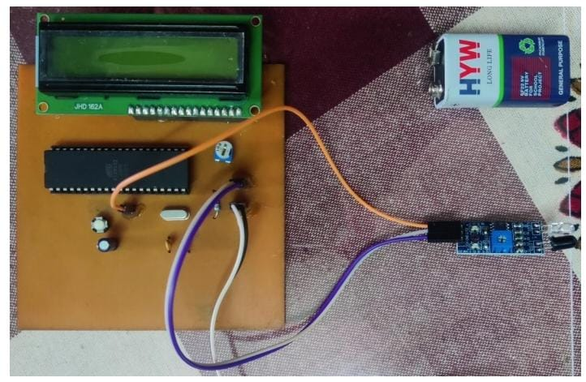

Slide 5
Components used
Microcontroller AT89S52
Push Button
Crystal Oscillator 11.0592MHz
33pf Ceramic Capacitor
IR Sensor
Battery(9V)
10k Resistor
LCD
Potentiometer 10k

Slide 6
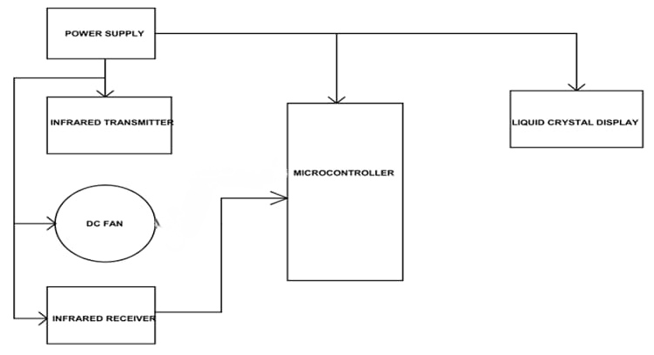
Block diagram

Slide 7
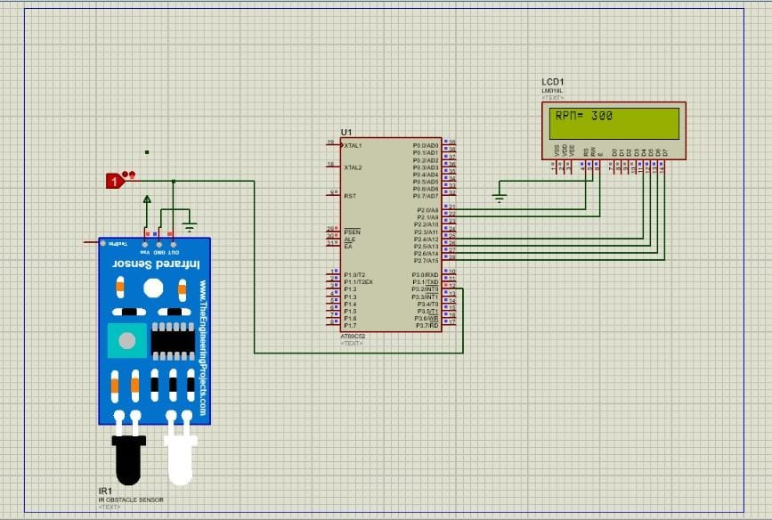
Circuit diagram

Slide 8
Basic operation
When the IR sensor is powered, the IR transmitter starts emitting IR rays. A motor is placed in front of the IR sensor, with its shafted marked with a white dot.
As the motor shaft rotates such that the white spots comes in contact with the sensor, the IR rays are reflected by the dot and falls on the IR receiver.
The photo diode, which is used as the IR receiver, starts conducting whenever the IR rays are reflected.
At this point, the output of the IR sensor is given to the comparator and the output of the comparator is HIGH when the IR rays are reflected and the output of the comparator is LOW when there are no reflections. Hence, the output of the comparator is in the form of an ON-OFF pulse.
This pulse is given to the microcontroller as a timer input and the microcontroller is programmed to calculate the number of times the motor rotates in a second.
The speed of the motor is calculated by multiplying the value of final count by 60 to get the speed in revolutions per minute. This value is then displayed on the 4-digit 7-segment display.

Slide 9
Applications
Some Applications of Tachometer are as Follow:
Used to calculate speed of rotating wheels.
Used to calculate speed of discs and Motor shafts.
This circuit can be used at places where direct contact with motor shafts or wheels is not possible to be made, as in case of vehicles and also in industrial machines.
This circuit can be used at homes to check speed of small battery operated fans and other motor based devices.

Slide 10
ADVANTAGES | DISADVANTAGES
The device can help prevent damage to equipment as well as reduce loss of material thanks to early detection of changes in the motor's speed. | It has limited life time due to use of battery for powering the circuit.
It is more reliable compare to traditional mechanical tachometer. | The ICs used in this circuit are CMOS devices and are highly static, making it impossible to touch them with bare hands.

Slide 11
conclusion
This is a very interesting project that helped us to correlate what we have studied in our subjects to real life.
A digital tachometer predicated on an infrared light reflection technique has been demonstrated prosperously. Its major advantage are that it doesn’t require any physical contact with the rotating shaft too quantify its celerity.
This project can be elongated further by integrating data logging feature too it
This brings us to the end of our presentation.

Slide 12
Thank you

